Slide 1
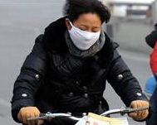
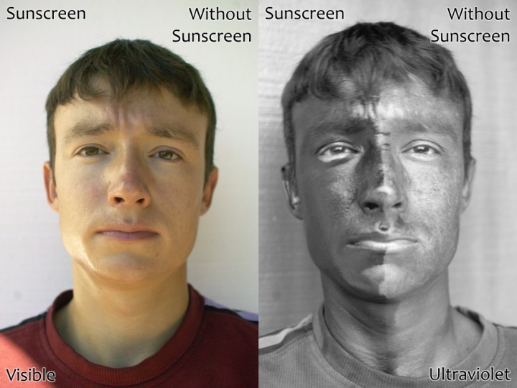
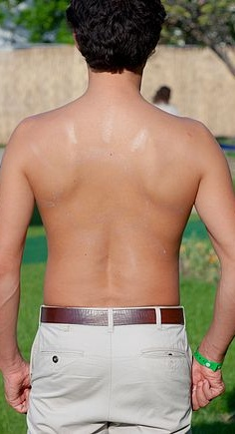
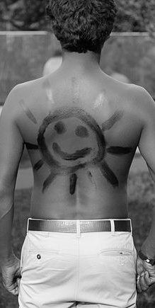
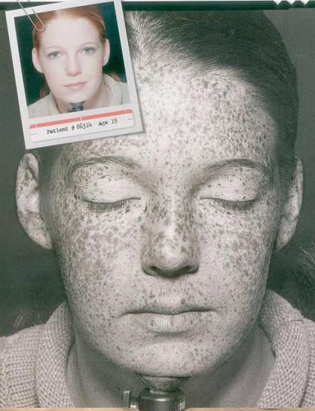
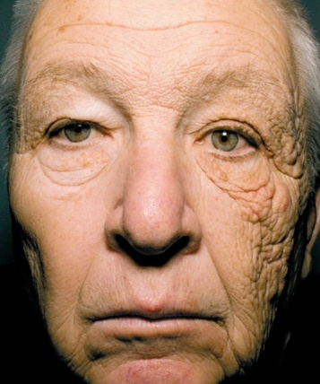
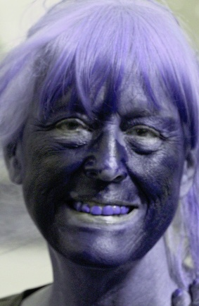
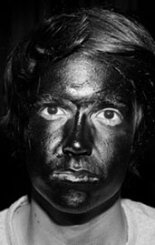
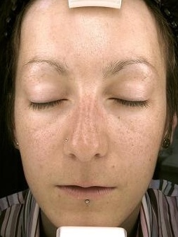
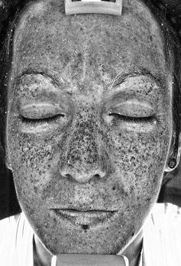
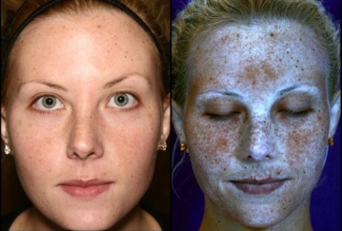
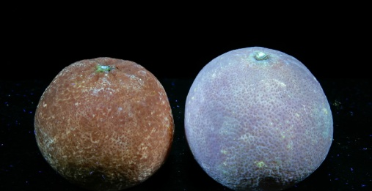
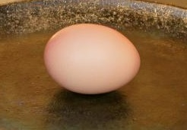
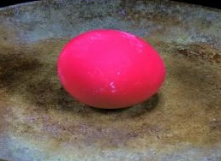
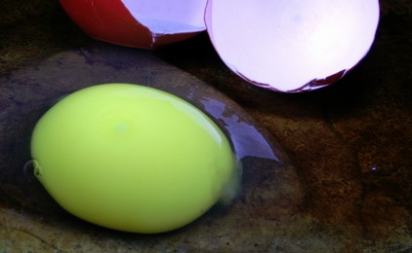
Lab 6: UV Light
& Air Pollution
UV photography reveals danger of Sun’s UV light and effectiveness of sunscreen.
UV photograph
Even with sun on left, sunscreen makes it darker.
Teeth reflect UV
Sunscreen revealed in UV photo
UV photographs
UV reveals skins damage
Truck driver UV skin damage
Sunscreen soaks up UV light
UV photos reveal skin damage caused by UV light in sunlight
UV Fluorescent dye
Oranges glow from UV light
Egg in visible light
Egg with UV induced fluorescence
Notes:
Red water is the Jianhe River in Luoyang, Henan province Dec. 13, 2011. Two chemical plants upstream.

Slide 2
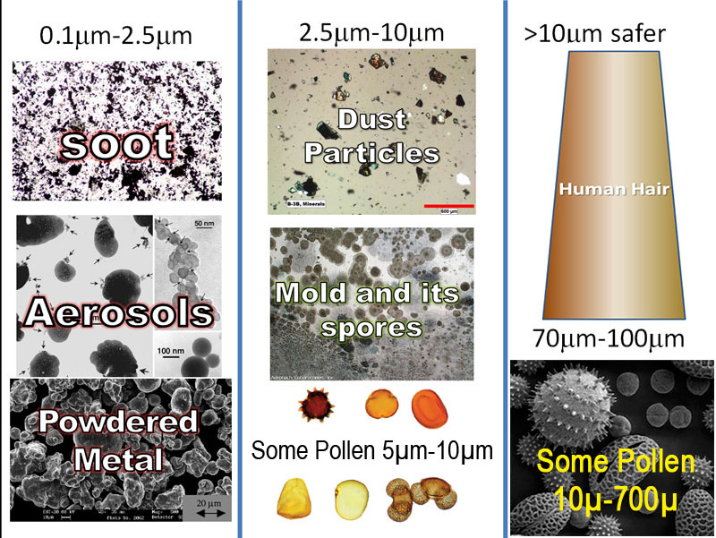
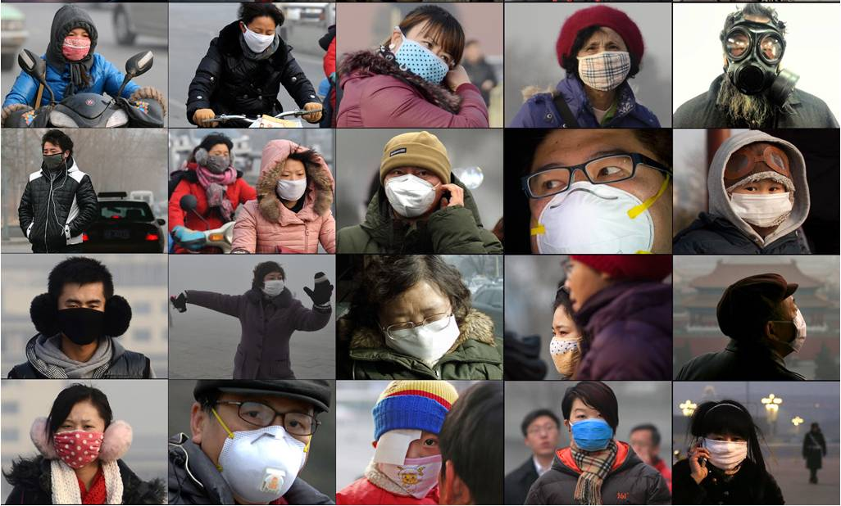
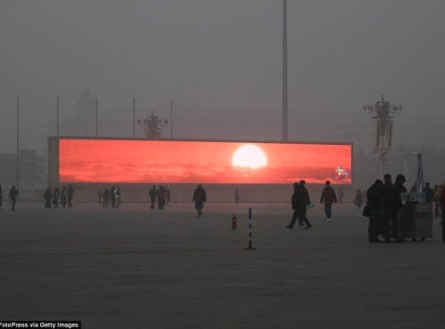
Lab 6: UV Light
& Air Pollution
Particulates we breathe
Smoke from a copper mine in Arizona
During periods of high pollution, people in Beijing wear masks.
Dust storm hits Phoenix
TV screens used to remind people what a sunrise and blue sky look like
Notes:
Red water is the Jianhe River in Luoyang, Henan province Dec. 13, 2011. Two chemical plants upstream.

Slide 3
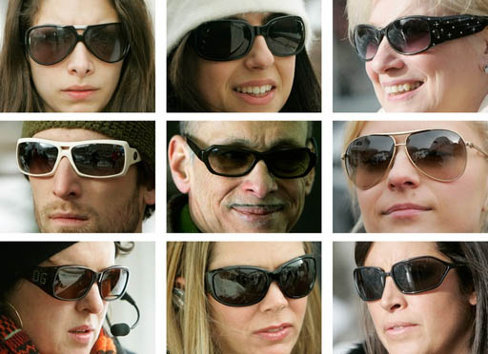
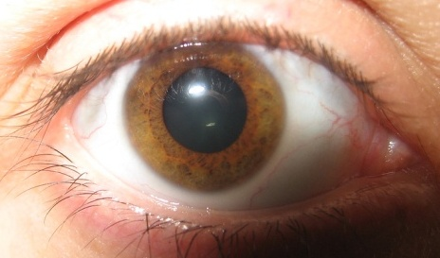
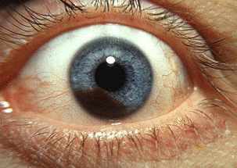
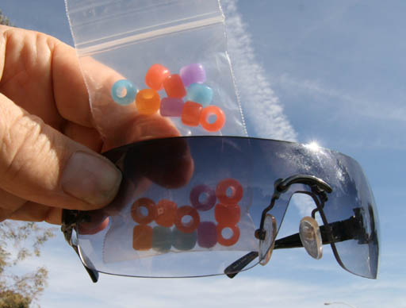
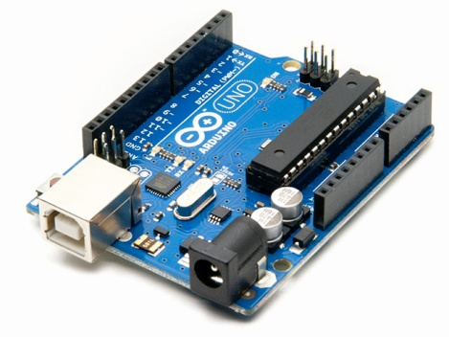
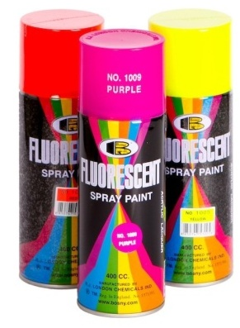
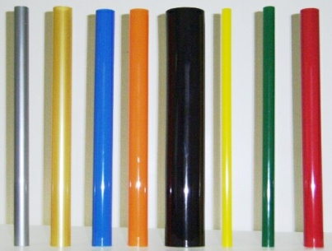
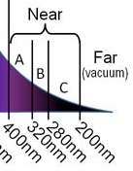
Lab 6: UV Light & Air Pollution: UV Light Protection
Sunglasses are best defense against UV damage to eyes:
Sunglasses are good for reducing glare but more importantly they reduce the UV light that hit our eyes. UV light contributes to cataracts (cloudiness) in the lens and to melanoma cancer that can affect the whole eye.
Cataracts
Melanoma
UV Light Detection: We will use 3 approaches for detecting how much UV light passes through a collection of sunglasses (including your own). 1) Beads that change color in the presence of UV light. 2) UV sensor attached to an Arduino microprocessor. 3) Fluorescent materials.
Check Sunglasses UV protection: A UV lamp will be used as a source of UV light or sunlight can be used.
Use the beads as shown in the photo above to have half of them exposed to the UV source directly and half being protected by the sunglass. When no UV light is hitting the beads, they are white. In the presence of strong UV light, the beads are multi-colored. From the level of color of the beads estimate the percentage of UV light each pair of Sunglasses are blocking.
Sunglasses #1 blocks: _______ % Sunglasses #2 blocks: _______% Sunglasses #3 blocks: ______ %
Check Sunglasses using UV light sensor hooked to Arduino: First read the UV level that the sensor sees without the sunglasses. Record that here(A): __________ Then place each of the three sunglasses in front of the sensor and get those levels. That will be how much UV light gets through(B).
UV level Sunglasses #1 ________ UV level Sunglasses #2 ________ UV level Sunglasses #3 ________
Now figure out how you would find out the percentage of UV light that each of those sunglasses blocked. (A-B)/A is fraction of full UV level blocked. Multiply by 100 to get fraction as a percent.
Sunglasses #1 blocks: _______ % Sunglasses #2 blocks: _______% Sunglasses #3 blocks: ______ %
Check sunscreen using UV light sensor hooked to Arduino: You will test different strengths (SPF=Sun Protection Factor). For example, SPF 30 means that 1/30 of the UV light will penetrate the sunscreen. Traditional sunscreen only blocks UVB wavelengths. Broad Spectrum sunscreen blocks UVA and UVB ranges. These are all broad spectrum. First get the UV level of the clear glass or plastic sheet without any sunscreen. UV level (C): ________ Now get the UV levels after the sunscreens are applied to that glass or plastic (D).
SPF 15 ________ SPF 30 ________ SPF 50 ________
Now figure out what percent of the UV light the sunscreens blocked. (C-D)/C x 100.
SPF 15 ______% blocked SPF 50 ________% blocked SPF 50 ________% blocked
Figure out the measured SPF value for each sunscreen. D/C is fraction that gets through. SPF is inverse= C / D
SPF 15 measured SPF:______ SPF 50 measured SPF:_____ SPF 50 measured SPF:_____

Slide 4
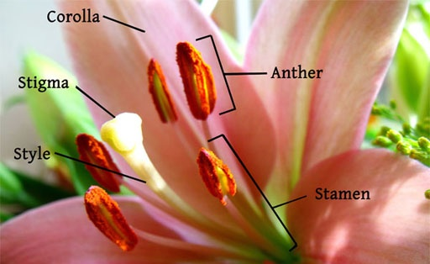
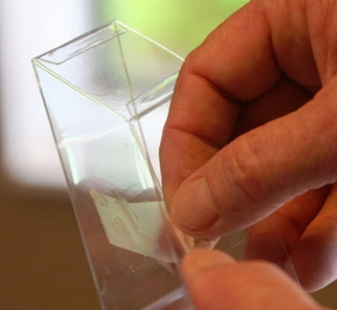
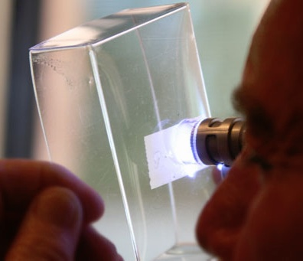
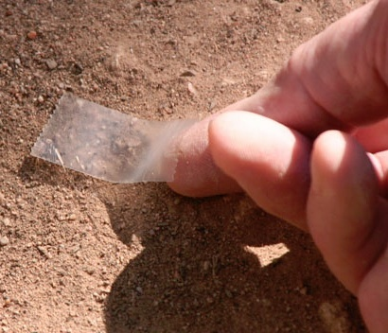
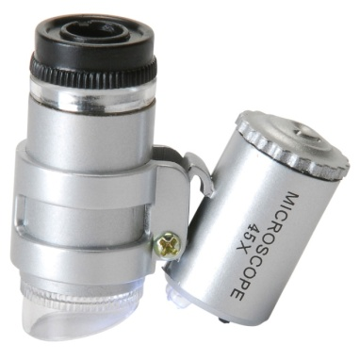
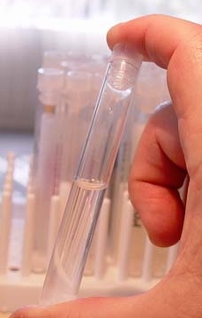
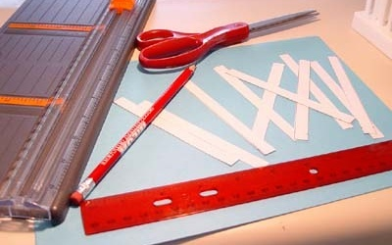
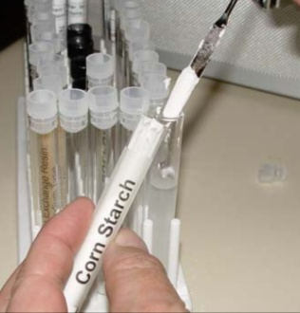
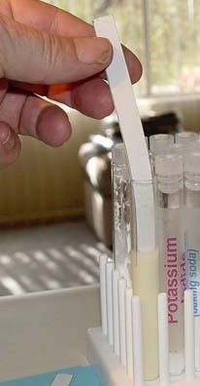
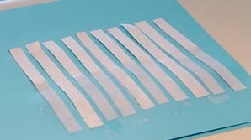
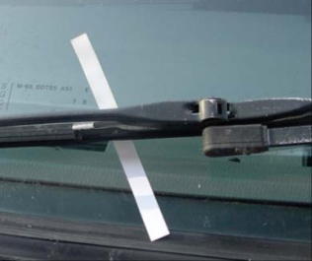
Lab 6: UV Light & Air Pollution: Air Pollution
POLLEN: Pollen is one of the common particulates in the air. For people with allergies, pollen is one of the biggest triggers of allergic reactions. Pollen is stored on the anthers, which sit on the ends of stalks called filaments. Collect pollen by touching the anthers with a piece of Scotch tape. Then place the tape on the inside of the acrylic box. Also get a sample of dirt with a piece of tape and apply it to the inside of the acrylic box. Using the mini-microscope, look at the pollen and dirt samples from the other side of the acrylic box.
Pollen: Describe the pollen you see on the back of this page or on another sheet of paper.
Dirt: Describe what the dirt looks like through the microscope. Use back of this page or another sheet of paper.
Ozone (a gaseous air pollutant): In addition to particulates in the air, there are unhealthy gases. Ozone (O₃) is one of them. Ozone can be detected by its ability to react with potassium iodide (KI) in the presence of moisture to make elemental iodine (I₂). Below is the chemical reaction.
2KI + H₂O + O₃ → 2KOH + O₂ + I₂
Potassium iodide + water + ozone → potassium hydroxide + oxygen + iodine
At the same time, moisture in the air causes some of the potassium iodide to break apart into positive potassium ions (K⁺) and negative iodide ions (I⁻). “(aq)” means dissolved in water.
KI + H₂O → K⁺_{(aq)} + I⁻_{(aq)}
The negative iodide ion (I⁻) can combine with the elemental iodine (I₂) to yield a negatively charged triiodide ion (I₃⁻).
25% of corn starch is a polymer of glucose (called amylose), which is shaped like a helix. The triiodide ion (I₃⁻) enters the center of the amylose helix and makes it turn reddish blue.
I⁻ + I₂ → I₃⁻
Making ozone test strips: 1) Using regular paper, draw out 10 rectangles that are each 12 centimeters long and 1 centimeter wide. Cut them out using scissors or paper cutter.
2) Weigh out approximately one gram of potassium iodide (KI) and place in test tube. Fill that test tube half full of distilled water and shake until the potassium iodide dissolves.
3) Add about 1 gram (2 scoops) of corn starch to that test tube and shake the solution again.
4) Dip each 12 cm x 1 cm strip of paper into the KI and corn starch solution (about half of the strip will get coated with solution).
5) Lay out the strips on towel so that they can dry and then put them in a plastic bag.
6) You will be taking the ozone test strips home so that you can test the ozone levels in your home and on your car.
7) Instructions for using the ozone test strips will be in the online lab manual.
(2)
(1)
(3)
(5)
(4)
(6)
Notes:
"Indonesia-sodis-gross" by SODIS Eawag - Own work. Licensed under CC BY 3.0 via Commons - https://commons.wikimedia.org/wiki/File:Indonesia-sodis-gross.jpg#/media/File:Indonesia-sodis-gross.jpg For sunlight sterilization of water.

